Slide 1



X
Bank Muamalat Business Intelligence Analyst
Virtual Internship Experience
Presented by :
Romadlon Iqbal Muktia

Slide 2






Romadlon Iqbal Muktia
X
romadloniqbalmuktia777@gmail.com
https://www.linkedin.com/in/romadloniqbalmuktia/
A results-driven person with a proven track record of helping organizations optimize operations, drive profitability, and achieve strategic goals. I'm motivated by new challenges because I always want to grow with the company.
https://github.com/romadloniqbal/Project-99

Slide 3
Outline
dataset
RELATIONSHIP TABLES
DASHBOARD
primary key
TABLE MASTER

Slide 4
About Dataset
This dataset contains four tables that will be used to create a Sales Dashboard providing information on orders, customers in different cities, products, and product categories from January 1st, 2020 to December 31st, 2021.

Slide 5
Define a Primary Key
A primary key is a column or series of columns in a database table that uniquely identifies each row or entity in the table.
1. Customer primary key table : Customer ID
2. Product primary key table : ProdNumber
3. Order primary key table : OrderID
4. Product Category primary key table : Category ID

Slide 6
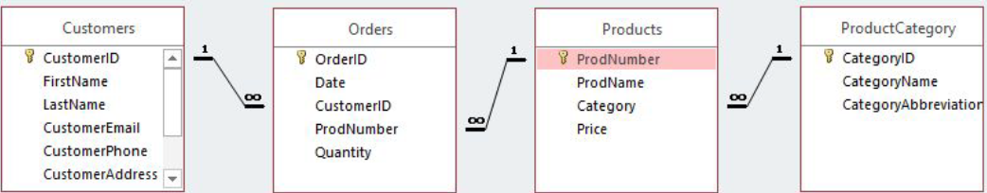
Determine a relationship between tables.
The term "table relationships" generally pertains to the connections or associations between various tables in a relational database. In such databases, data is arranged into tables, where each table corresponds to a distinct entity or concept, and each row within the table represents a singular occurrence of that entity. These table relationships are built using keys, which usually include primary and foreign keys.

Slide 7
Determine a relationship between tables.
The following relationship for each table is :
•Customers.CustomerID = Orders.CustomerID with one to many relationship.
•Orders.ProdNumber = Producsts.ProdNumber with many to one relationship
•Products.Category = ProductCategory.CategoryID with many to one relationship

Slide 8
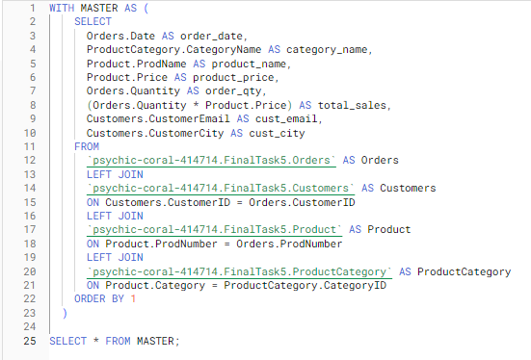
Create a Table Master
The purpose of this master table is to combine 4 tables using Google BigQuery queries. The resulting data will be visualized on a dashboard with the following features :
•CustomerEmail(cust_email)
•CustomerCity(cust_city)
•OrderDate(order_date)
•OrderQty(order_qty)
•ProductName(product_name)
•ProductPrice(product_price)
•ProductCategoryName(category_name)
•TotalSales(total_sales)

Slide 9
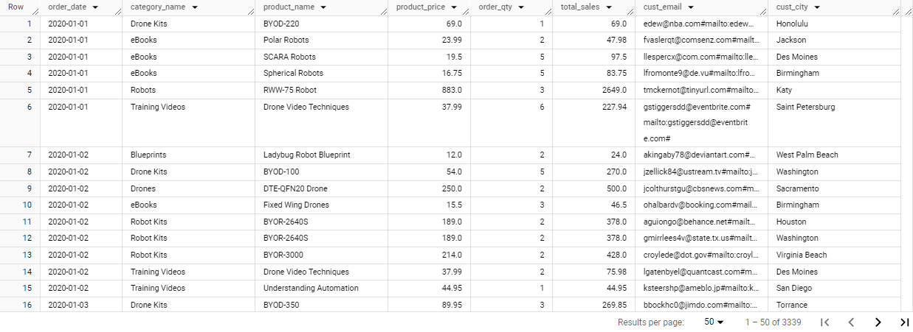
Query Results

Slide 10
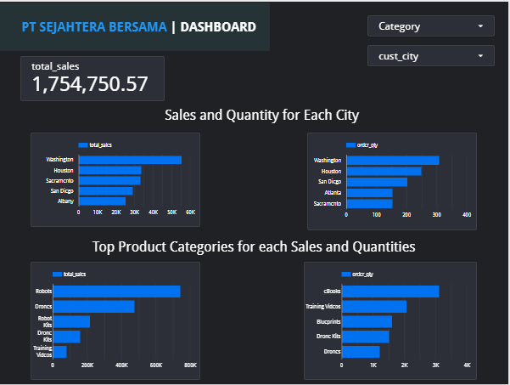

Dashboard
Dashboard Link

Slide 11
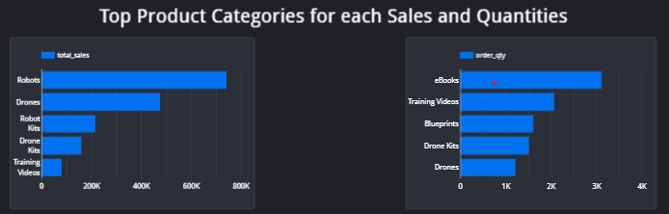
Suggestion
Based on data viz, we can conclude that :
eBooks are the most popular product in terms of quantity, while robots are the highest-selling category. Based on this data, I recommend to increase inventory for the top 5 product categories to boost sales

Slide 12


Access Link
https://console.cloud.google.com/bigquery?project=psychic-coral-414714&ws=!1m9!1m4!1m3!1spsychic-coral-414714!2sbquxjob_5532ba63_18dd39b95bd!3sasia-southeast2!1m3!3m2!1spsychic-coral-414714!2sFinal_Task_5
https://lookerstudio.google.com/u/0/reporting/85647982-451c-403d-bf37-b006202a00a1/page/8mDrD
https://github.com/romadloniqbal/Project99/tree/main/Bank%20Muamalat%20Business%20Intelligence%20Analyst%20Project%20Based%20Internship%20Program

Slide 13
Thank You
X

